Slide 1




DAMAGE PREVENTION and the One Call Process
Statewide: 1-800-331-5666
Nationwide: 811
Online: www.ne1call.com

Slide 2


Slide 3

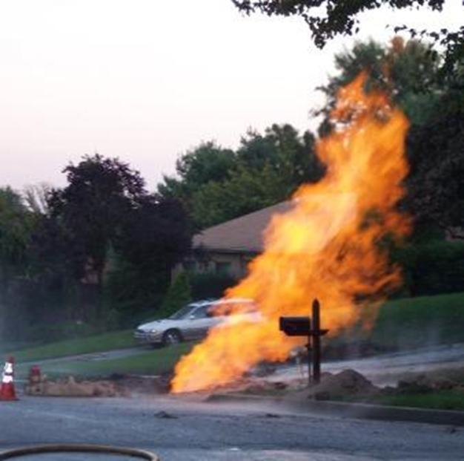

MISSION AND GOALS
Nebraska811
SAFE DIGGING
Protecting the general public and the environment
DAMAGE PREVENTION
Protecting the underground facilities

Slide 4



811 Basics
  Applies to Everyone, Everywhere
  One Call Notification Act of 1994
    One-Call Board of Directors
    State Fire Marshal
    Attorney General
  Free service/utilities pay to protect
  Protects underground utilities, excavators, general public, environment
  Needed now more than ever

Slide 5
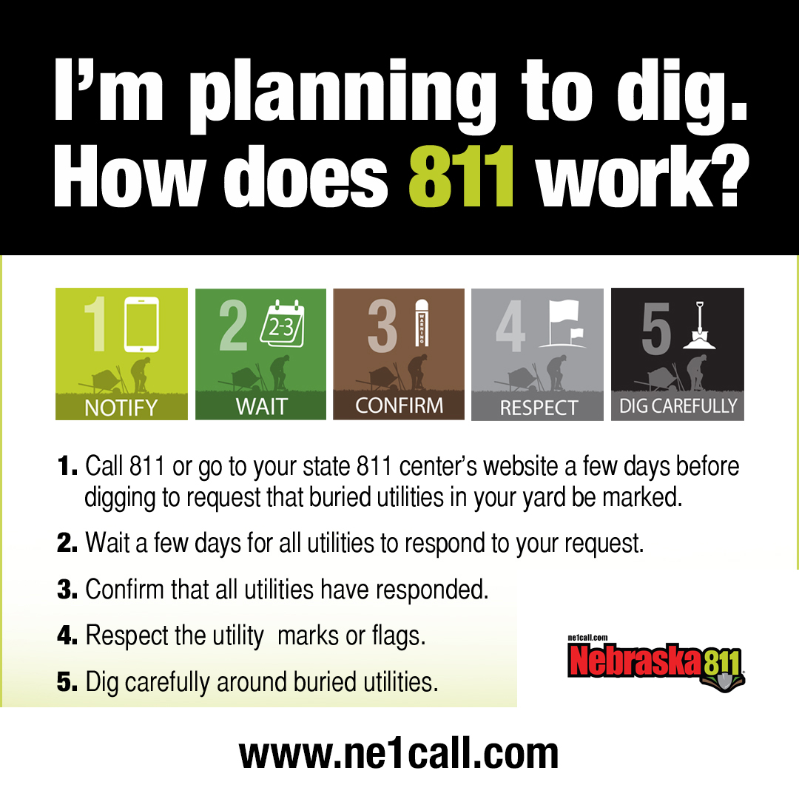

Slide 6
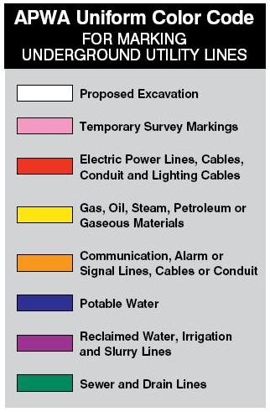
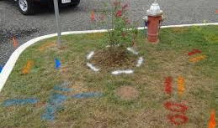

The COLOR CODE
ELECTRIC
GAS
CABLE
WATER
SEWER
PROPOSED EXCAVATION

Slide 7

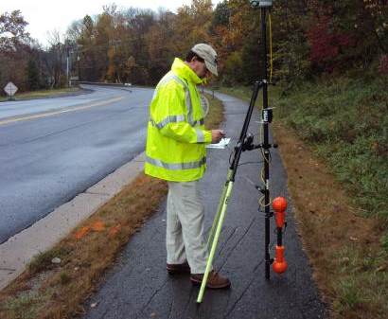

THE NE ONE-CALL NOTIFICATION SYSTEM IN ACTION:
The utilities must respond back to the excavator
Excavator provides accurate information in a timely manner
The call center must collect the information correctly and notify the correct utilities
Each stakeholder renders a critical role.

Slide 8
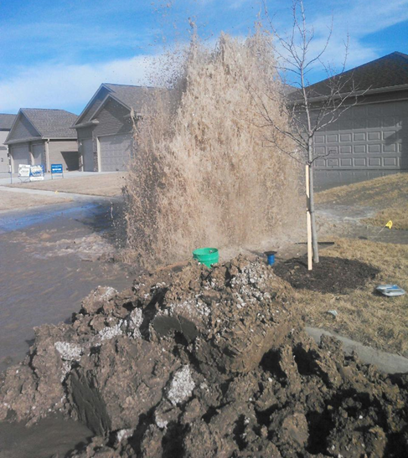
CGA Homeowner Survey
40% of homeowners plan to dig this year
Nearly half (45%) will NOT call before they dig
  2/3 believe they will not hit an underground utility
Damage occurs less than 1% of the time IF
    the homeowner calls before they dig.

Slide 9
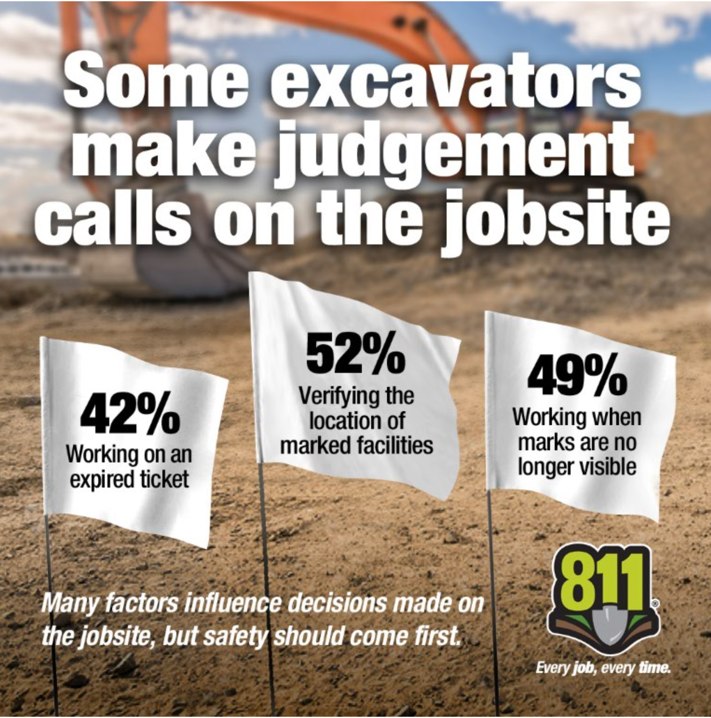

GOALS
Nebraska811
Do your part to avoid damaging an underground line.
Notes:
Keyword – active excavation.

Slide 10
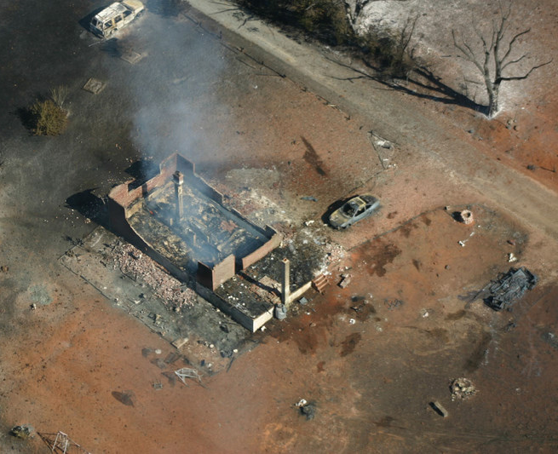
CONSEQUENCE OF A DAMAGE
INJURY
DAMAGED UTILITIES
  Loss of use
  Repair costs
FINES
  Up to $10,000 per day

Slide 11
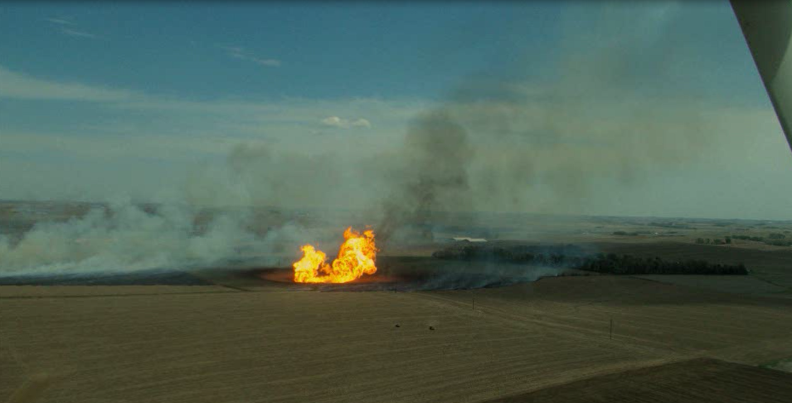

Slide 12
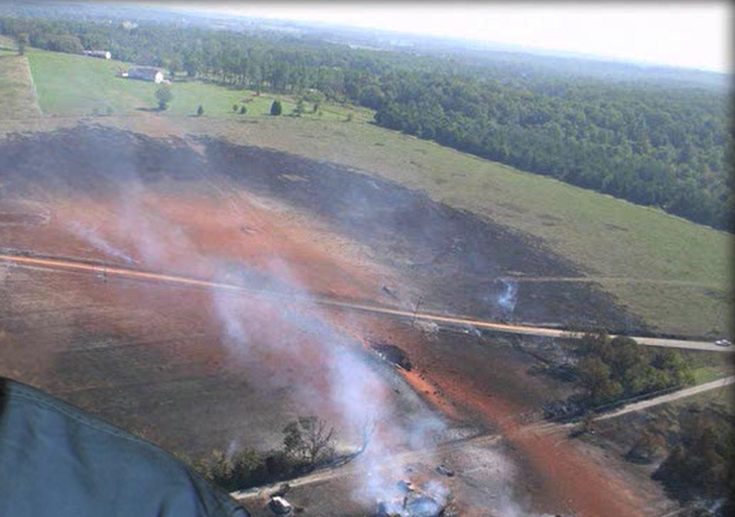

Slide 13
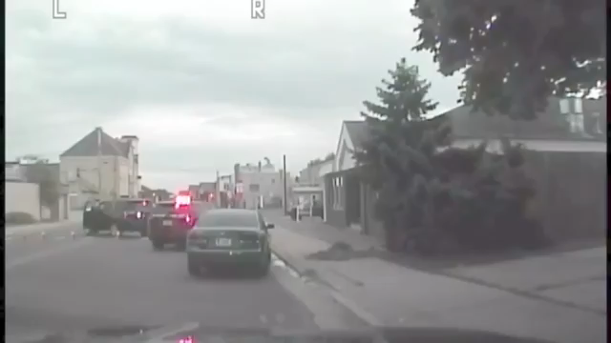

Slide 14

Signs of a PIPELINE INCIDENT
What do you:
SMELL
    Distinctive odor (mercaptan)
SEE
    Dead vegetation
    Sheen on water/bubbling
    Fire/vapor
HEAR
    Hissing or roaring

Slide 15
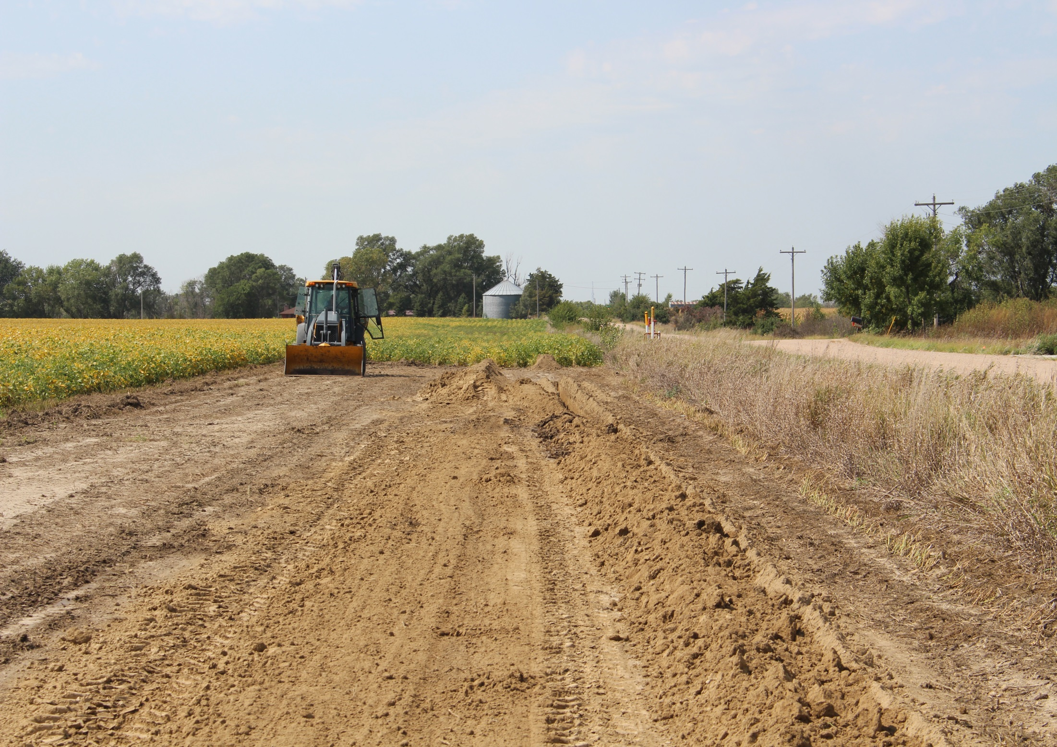
What’s Wrong with this picture?

Slide 16
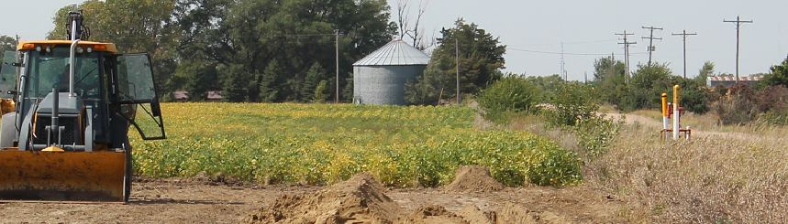

What is missing?

Slide 17
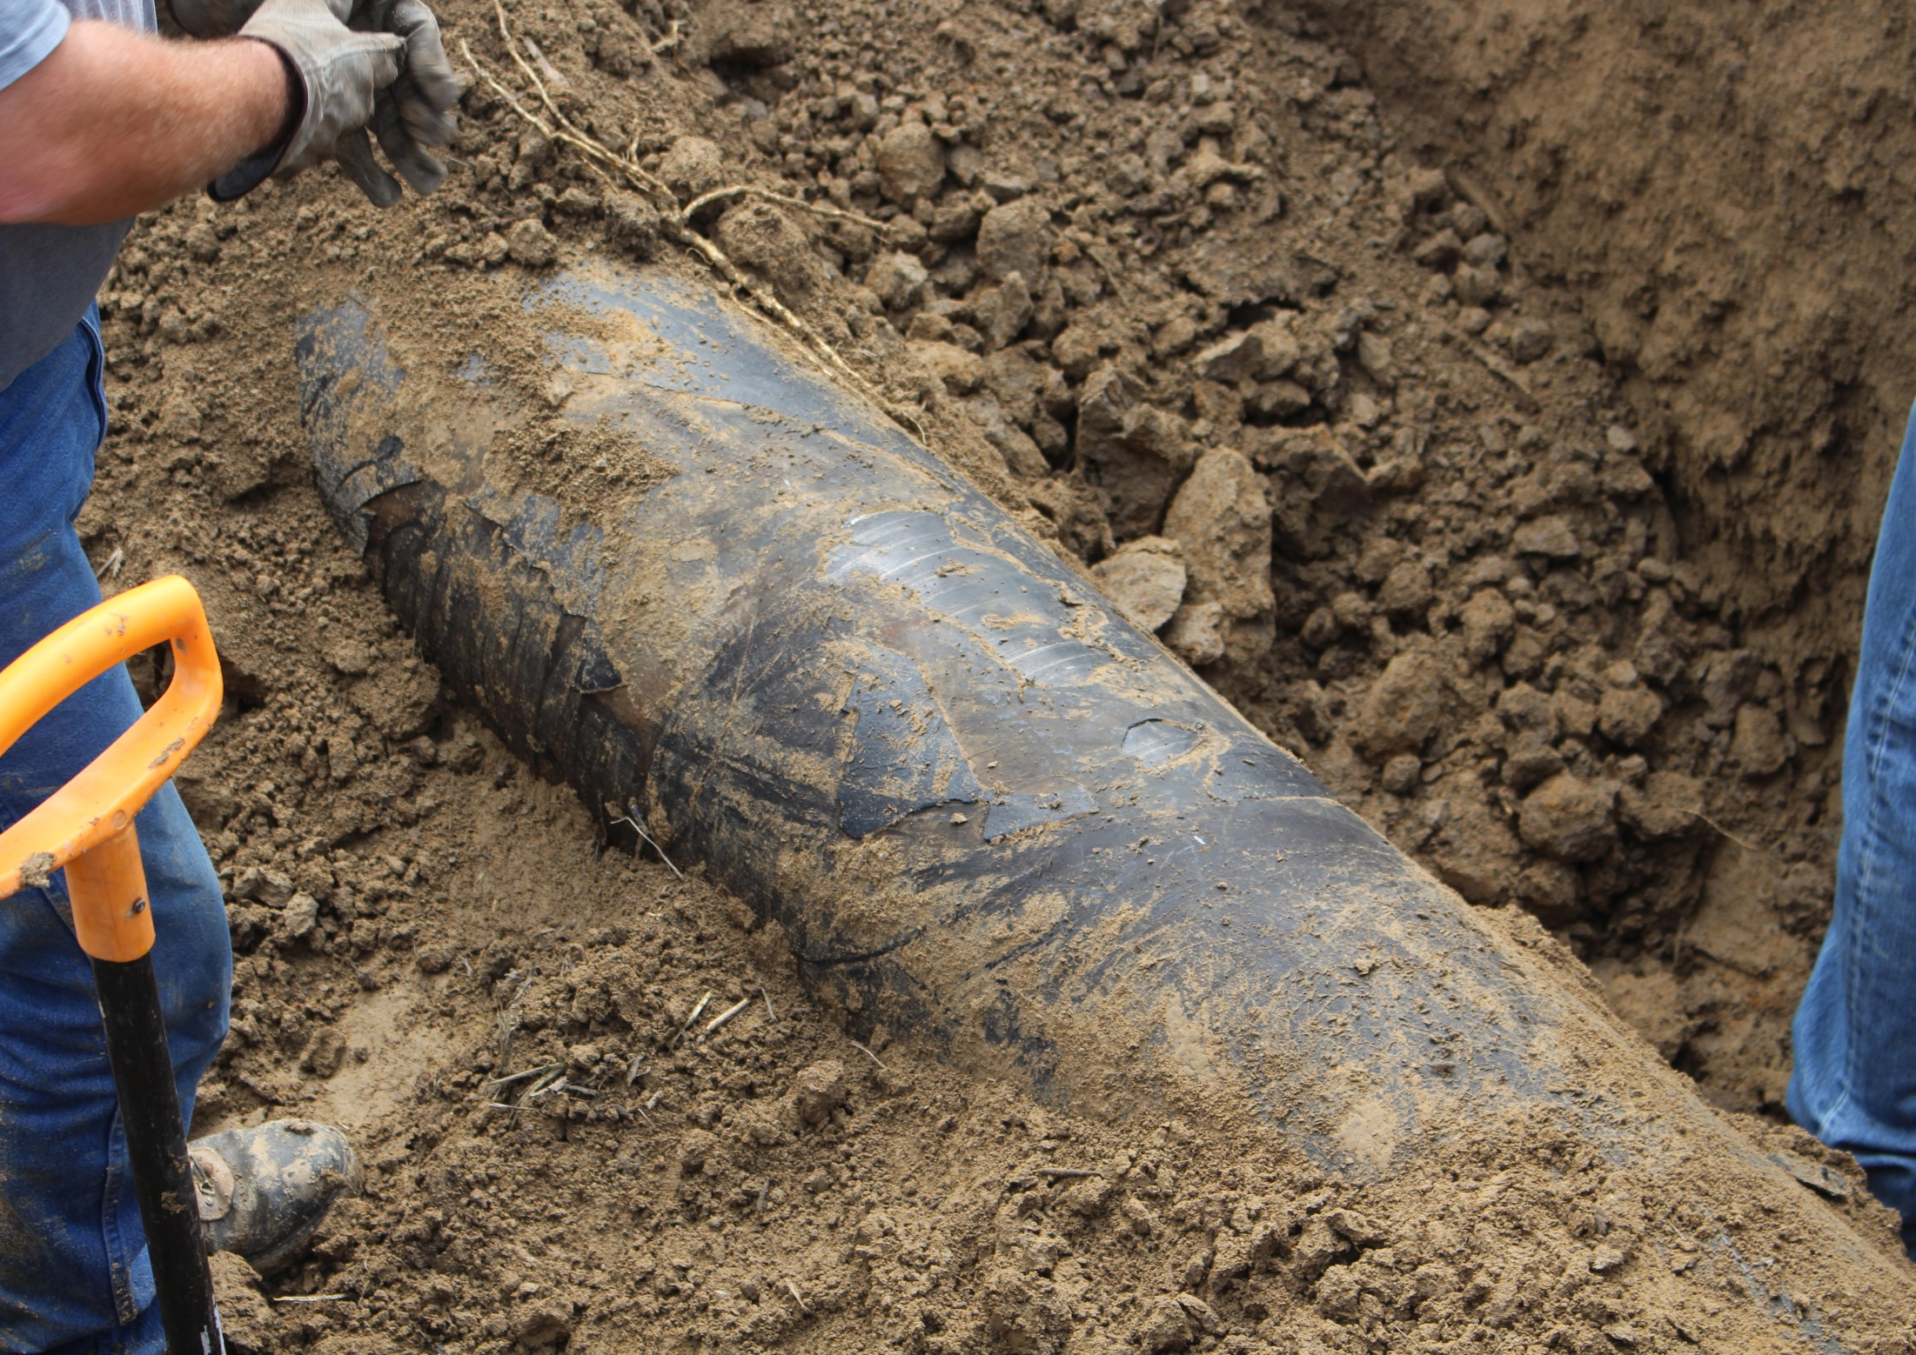
16 inch Transmission Pipeline
Operating at 650 psi

Slide 18
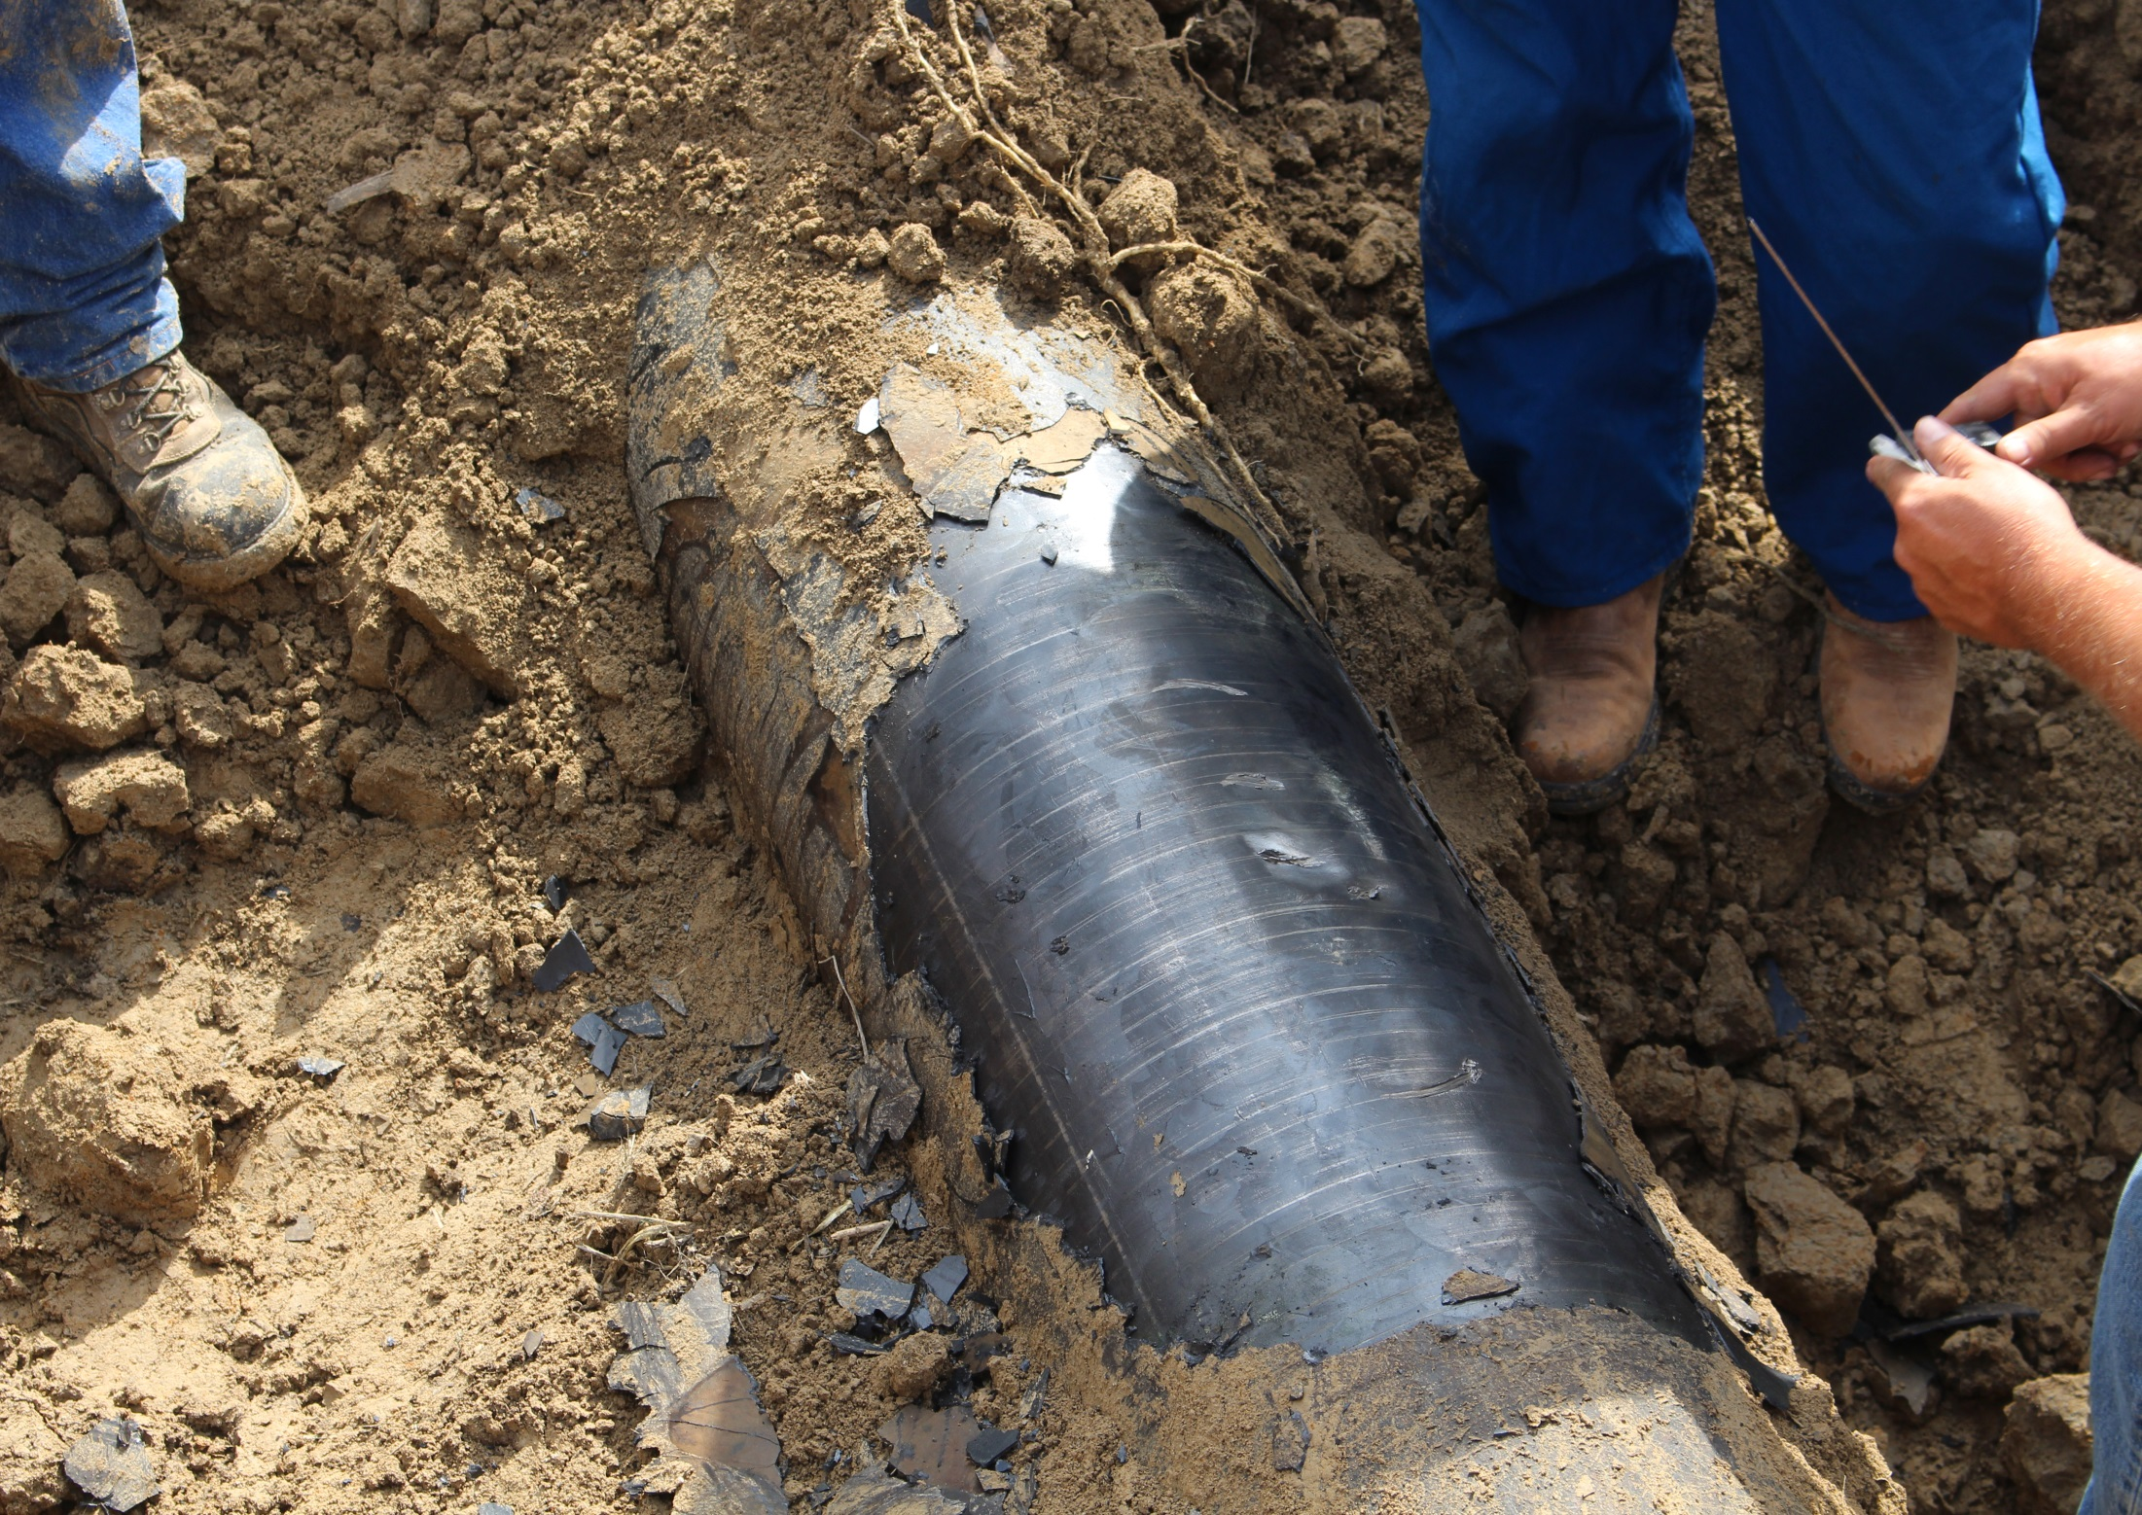

Slide 19
GOALS
Nebraska811
How can Nebraska811 help?
Nebraska811 strives to be your
DAMAGE PREVENTION PARTNER
Helping to facilitate the One Call Process
      Call Center functions and tools
        Fast, accurate ticketing
        State of the art technology
      Member assistance
        Helping member utilities fulfill their responsibilities
      Education and Outreach
        Excavators, Members, General Public
Notes:
Keyword – active excavation.

Slide 20
GOALS
  Goals for Stakeholders: Excavators/Members
      Know the responsibilities under the law
      Utilize technologies available to make the job efficient and effective in preventing damages
      Help with public awareness

Slide 21

MISSION AND GOALS
Nebraska811
Purpose – PUBLIC AWARENESS
Damages occur less than 1% of the time when a locate request is in place
DAMAGE PREVENTION
Name Recognition
More likely to place a locate request
Less likely to have a damage
Notes:
To take it one step further

Slide 22
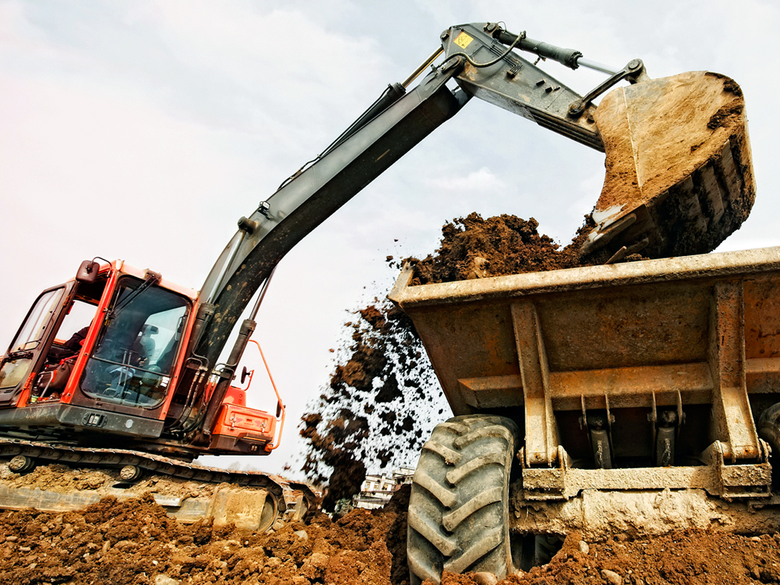


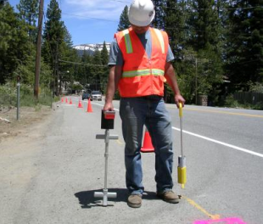
THE NE ONE-CALL NOTIFICATION SYSTEM ACT OF 1994 REQUIRES:
All operators of underground facilities to be members of and participate in the statewide one-call notification center.
76-2318
Every person to contact the statewide one-call notification center and provide the required notice prior to beginning any excavation.
76-2321
Every utility that receives a locate request must respond to the excavator by either marking or indicating no conflict.
76-2323

Slide 23
Each Stakeholder has responsibilities:
Excavator
Utility Owner/Locator
Call Center
File a locate request before digging
Wait for markings
Dig with care
Respect the Marks
Report damage
Report no responses or incorrect locates
Refresh if necessary
White line/Pre-mark the dig area
Membership with the Call Center
Respond to locate requests
  Locate lines
  Notify exacavator that they are clear to dig
Respond to emergencies
Receive locate request and notify the utilities
Receive and record damage data
Public Awareness
**The Call Center DOES NOT:
    Locate the lines
    Enforce the law
**The Attorney General enforces the law

Slide 24

THE NE ONE-CALL NOTIFICATION SYSTEM ACT OF 1994
Updated 10/2020!

Slide 25
THE NE ONE-CALL NOTIFICATION SYSTEM ACT Sections 76-2301 to 76-2332
BOARD OF DIRECTORS
The board is composed of 18 members representing the following:
3 – Members representing “Municipally-Owned Utilities”
2 - Members representing “Public Power Districts with more than $40 Million in Gross Revenue”.
2 – Members representing “Public Power Districts with less than $40 Million in Gross Revenue”.
3 – Members representing “Telecommunications” companies.
2 – Members representing “Natural Gas Distribution” companies.
2 – Members representing “Transmission Pipeline” companies.
4 – Member representing “Excavators, with one member specializing in trenchless excavation activities and one member representing county governments.”
COMPOSITION OF THE CURRENT BOARD OF DIRECTORS effective 8/2019

Slide 26
THE NE ONE-CALL NOTIFICATION SYSTEM ACT Sections 76-2301 to 76-2332
BOARD OF DIRECTORS
What the Board of Directors do:
Appointed by the State Fire Marshal’s Office.
Select a vendor to operate the One-Call Center.
Oversee the operations of the Center.
Set business rules, policies and fee structures for the Center.
Determine how we perform public outreach through marketing and excavator meetings throughout the state.
Work with all stakeholder groups to determine future best practices and new rule and regulations in regards with the One-Call Notification Act.
Review new or pending legislation effecting the One-Call Act and respond if necessary.

Slide 27
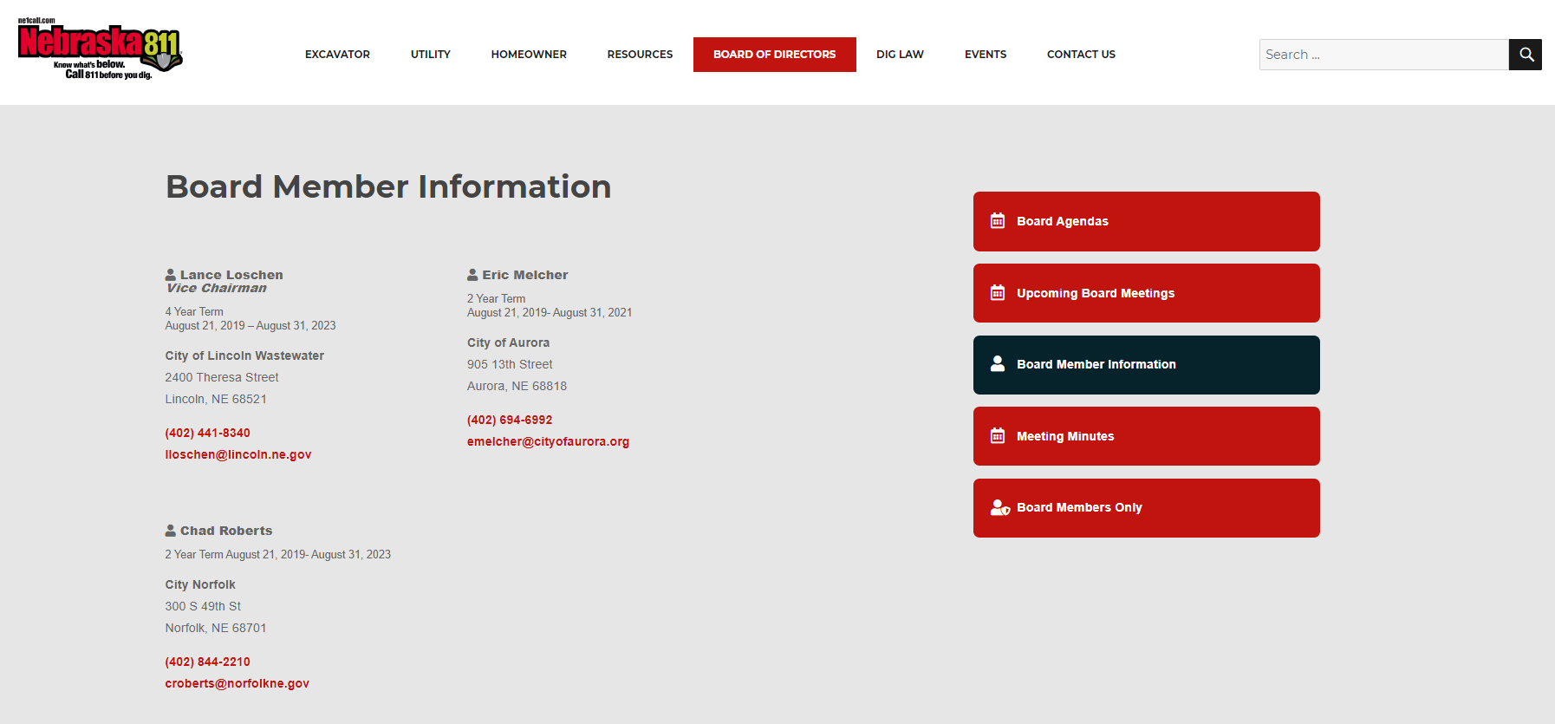
BOARD OF DIRECTORS
Nebraska811
Board Member contact information is available at ne1call.com
Nebraska811
Notes:
Keyword – active excavation.

Slide 28

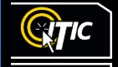
STATE OF THE ART
TECHNOLOGY
Utilize the FREE damage prevention tools available
ITIC - PLACING a locate request
LTM - RESPONDING to a locate notification – Ticket Management
ETM – MANAGE tickets on the Excavator side
IMAP - UPDATE and MANAGE member utility data

Slide 29

HOW TO PLACE A LOCATE REQUEST
PHONE
  800-331-5666 or 811
  Avoid heavy call times
    (Mondays 8-10 am)
Online via ITIC
  Time saving features
  Auto-fill for repetitive job types
  5 year Ticket history
  YTD ITIC usage 2020– 72%
  Mobile version available
IVR – REFRESH ONLY
24/7/365

Slide 30

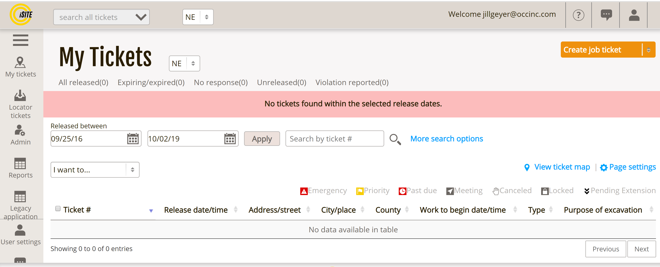
ITIC Nxt is HERE!
  Multiple NEW map tools
  System generated locate instructions
  Create Multiple tickets in one session
  Direct release
  Built in business rules
  Interactive video training
  Future tickets can be pended for release
  Emergency, Damage, Incorrect, Non-response tickets available online
  Features retained from ITIC 2.0
  Multiple map sources
  Custom Templates for similar tickets
  Identify, Placemark, Measure
  Live Chat support
EXCITING NEW FEATURES

Slide 31
ITIC (internet tickets) and LTM - Locator Ticket Management
  ONLINE INTERACTIVE TRAINING TOOLS
  Train at your own pace
  Repeat the instructions as many times as necessary
  Go live when you are ready
Visit to www.ne1call.com for the interactive training links

Slide 32
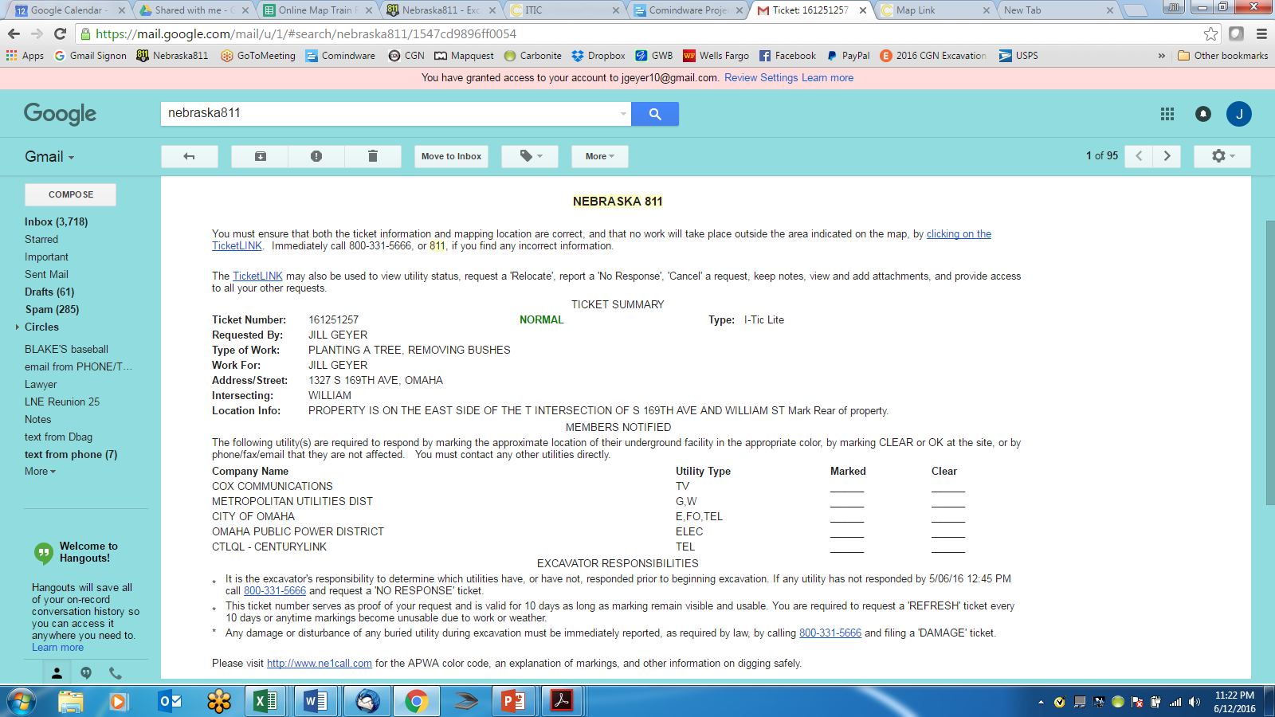
Verify Your One Call Ticket Information
Verification is your Responsibility
Every excavator that provides an email address receives a free copy of their locate request.
Each email copy of the ticket contains a TicketLINK
Verify Mapped Area
Access all Ticket History
Refresh Historical Tickets
View Real Time Utility Status
Add Attachments
Cancel
File a Non-Response Ticket
Documentation

Slide 33
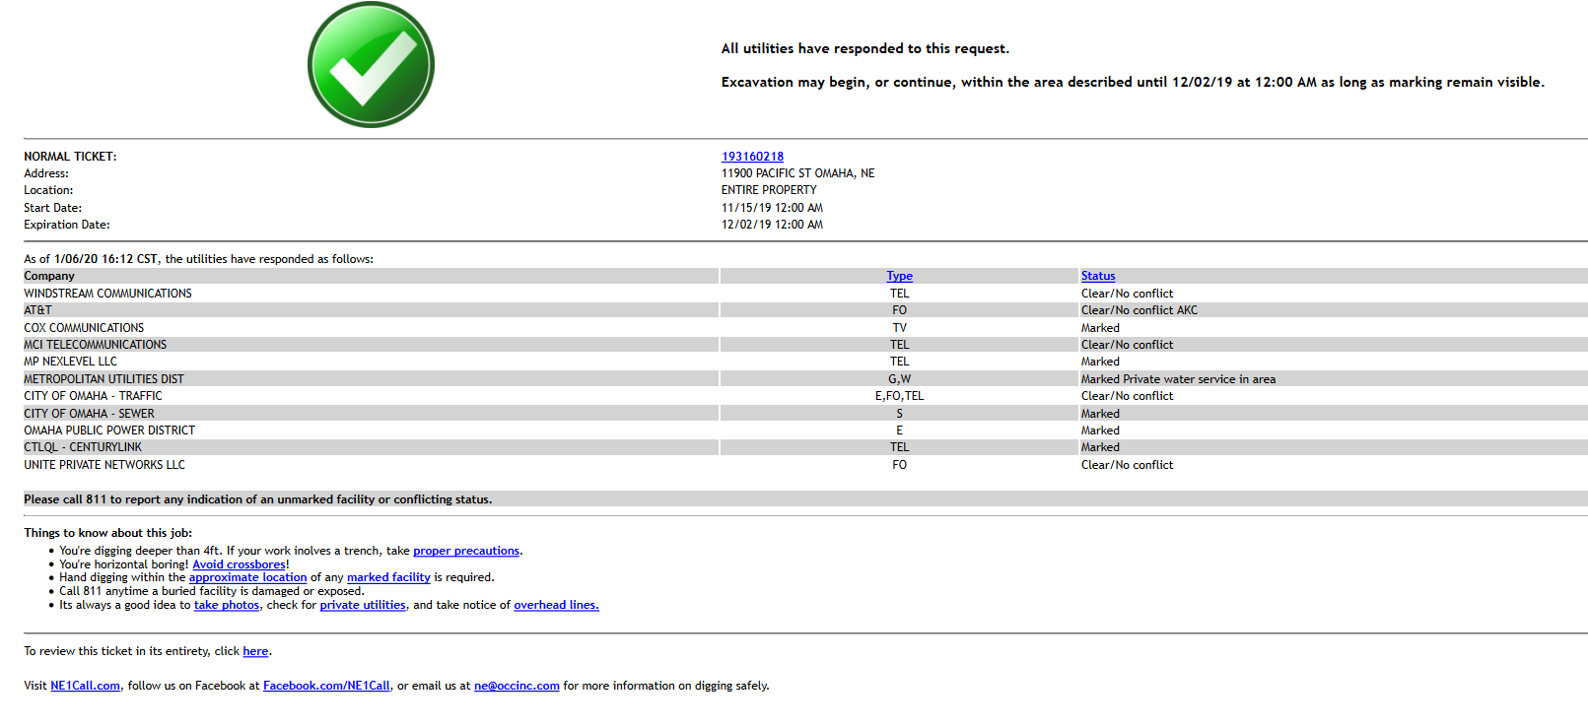

Slide 34
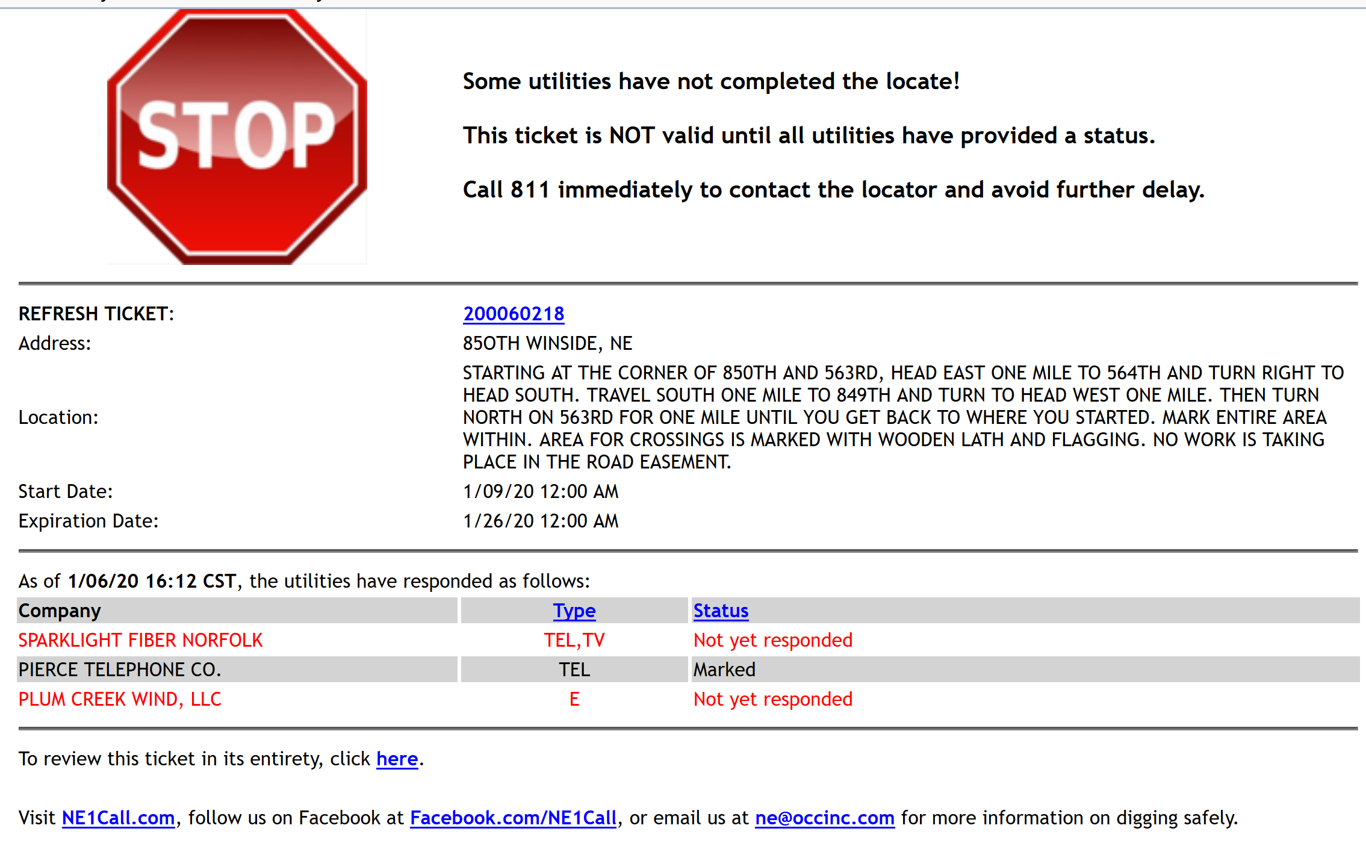
Excavation should NOT begin until all utilities have provided a status.

Slide 35
GOALS
Nebraska811
One Call 101
ONE CALL BASICS
DAMAGE - What to do in case of damage
  REPORT
  Document – take pictures, videos
  Call 911 if release of gas/hazardous material
INCORRECT LOCATE – report within 72 hours
NON-RESPONSE TICKET – file when applicable
VIOLATIONS - reported to Attorney General’s office
Have your ticket accessible on job site
Notes:
Keyword – active excavation.

Slide 36

New RULES AND REGULATIONS
CALL 911
If an excavator causes a release of natural gas or any other hazardous material, they must call 911 first, then 811 (who then notifies the facility owner).
Notes:
Keyword – active excavation.

Slide 37
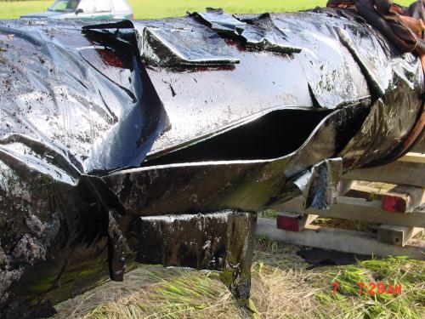
Effective January 1, 2016: 49 CFR 196
The excavator is now included in 49 Code of Federal Regulations Part 196 (49 CFR 196) which states:
If damage occurs to a utility, call the one call center and report the damage
If the utility is a pipeline, call the one call center and the pipeline operator of the damage
If the damage to the pipeline caused a release of the product, call 911, 811 (who notifies the pipeline operator).
c. An excavator who causes damage to a pipeline facility:
i. Must report the damage to the operator of the facility at the earliest practical moment following discovery of the damage; and
ii. If the damage results in the escape of any PHMSA regulated natural and other gas or hazardous liquid, must promptly report to other appropriate authorities by calling the 911 emergency telephone number or another emergency telephone number.

Slide 38
DAMAGES
Nebraska811
Nebraska811
DAMAGES
MUST BE REPORTED to 811
per 76-2326
Notes:
Keyword – active excavation.

Slide 39
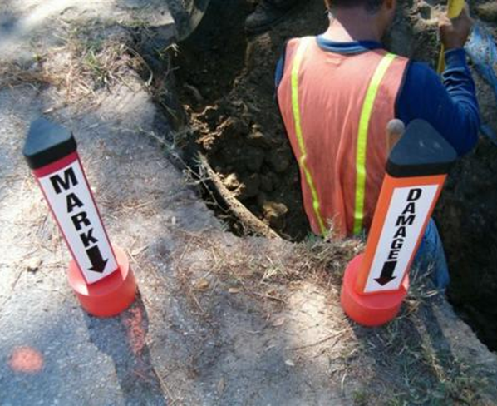
76-2326 NEBRASKA STATE LAWS REQUIRE THE EXCAVATOR TO CALL NEBRASKA811
IF A DAMAGE TO AN UNDERGROUND UTILITY OCCURS
Reporting Damages to Nebraska811
All Damages must be CALLED in to Nebraska811
Be prepared to provide corresponding ticket number or notify call center operator If no corresponding ticket exists
Provide location of damage and what utility (if known) was damaged
Nebraska811 will notify all Member utilities located in or near the area of the reported damage
A DAMAGE NOTIFICATION IS NOT A REQUEST FOR MARKING BUT A NOTICE OF DAMAGE OR DISTURBANCE OF AN UNDERGROUND FACILITY. ONLY THE AFFECTED FACILITY OWNER/OPERATOR IS REQUIRED TO RESPOND.

Slide 40
DAMAGE DOCUMENTATION
PICTURES/VIDEO
Pictures – good vs bad:
Pictures with date, time reference
Description of what picture illustrates:
  damage i.e. scraped, perforation caused by (type of machine)
  Scope of work
Measurement reference – tape measure or common object
Identifiable object in background for reference – building, street sign
Notes:
Keyword – active excavation.

Slide 41
One Call Violation
Complaint Form
Notes:
Keyword – active excavation.

Slide 42
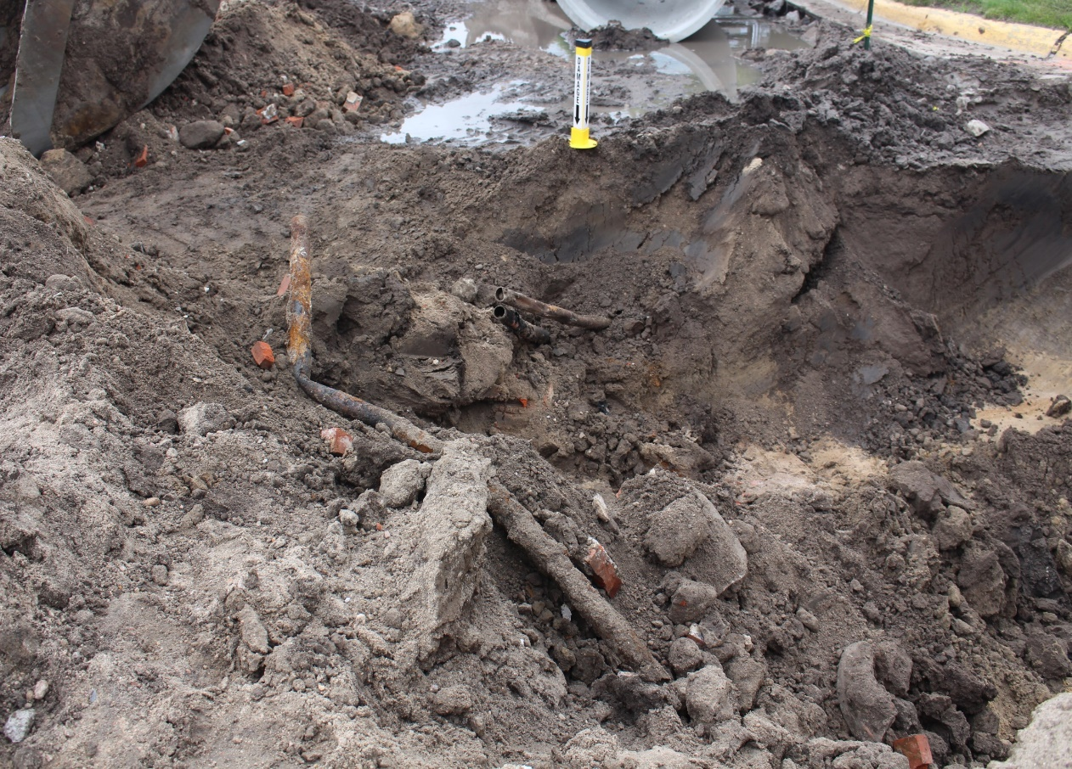
One Call Violation
Complaint Form
Notes:
Keyword – active excavation.

Slide 43
Incorrect location
76-2327
If in the course of excavation, the excavator discovers that the operator has incorrectly located the underground facility, he or she shall notify the center as soon as practical but no later than seventy-two hours after discovery.
Notes:
Keyword – active excavation.

Slide 44
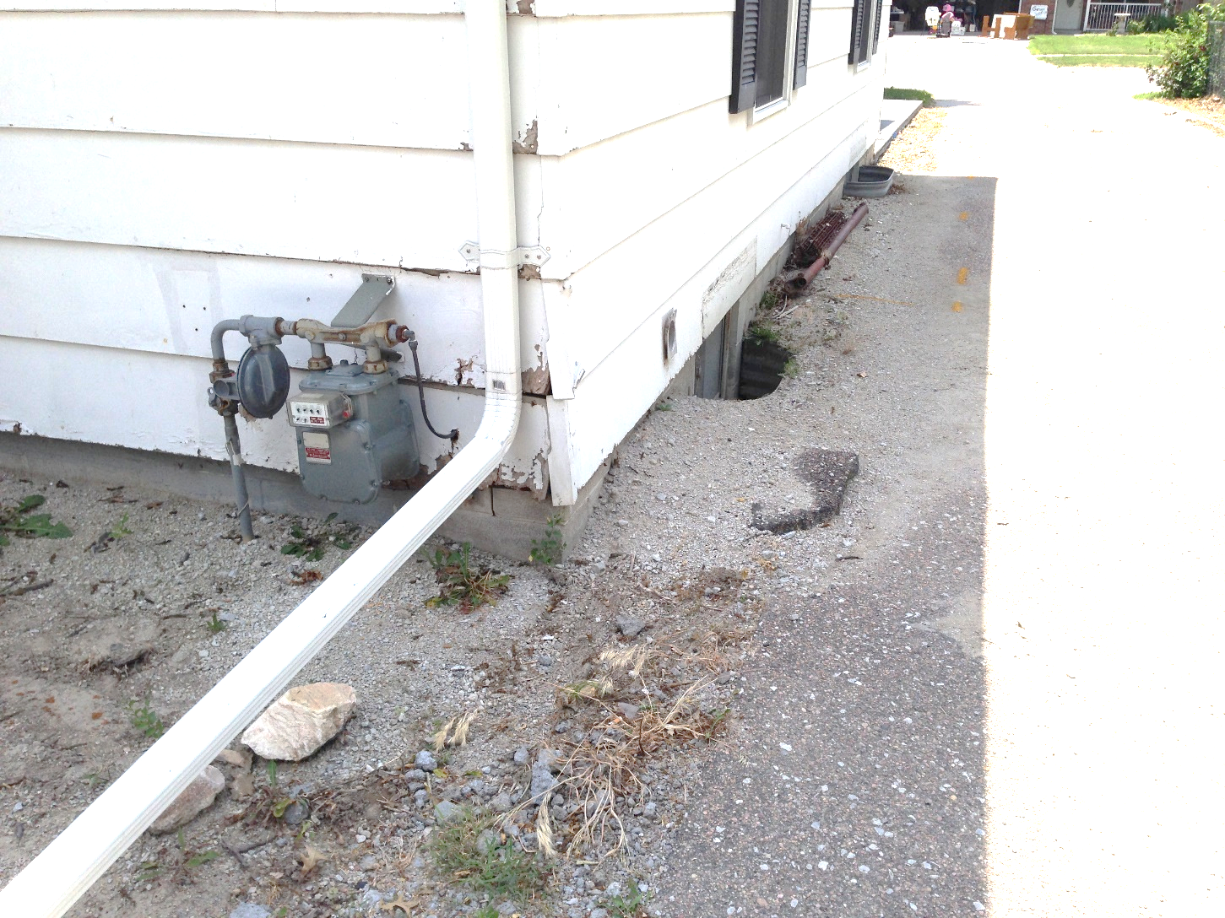
Incorrect Locate Example
  GAS METER
  MARKS
  Incorrect locate example – picture shows meter with no marks
Notes:
Keyword – active excavation.

Slide 45
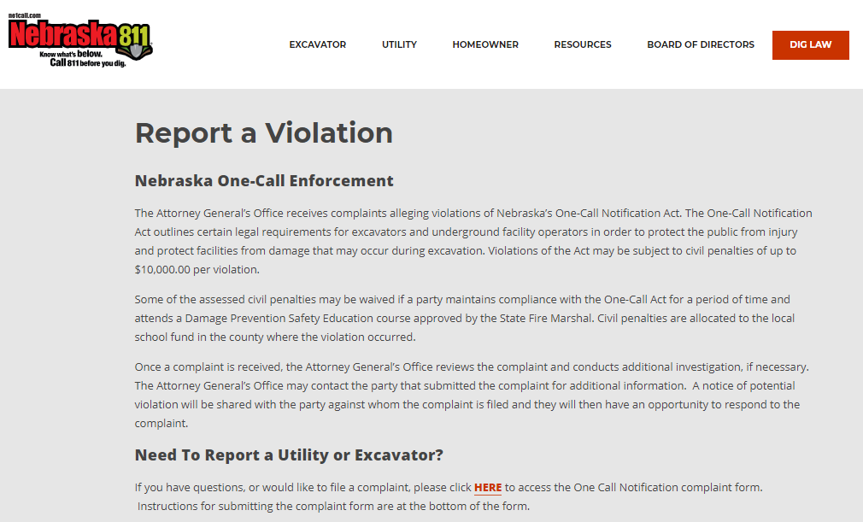
REPORT VIOLATIONS

Slide 46
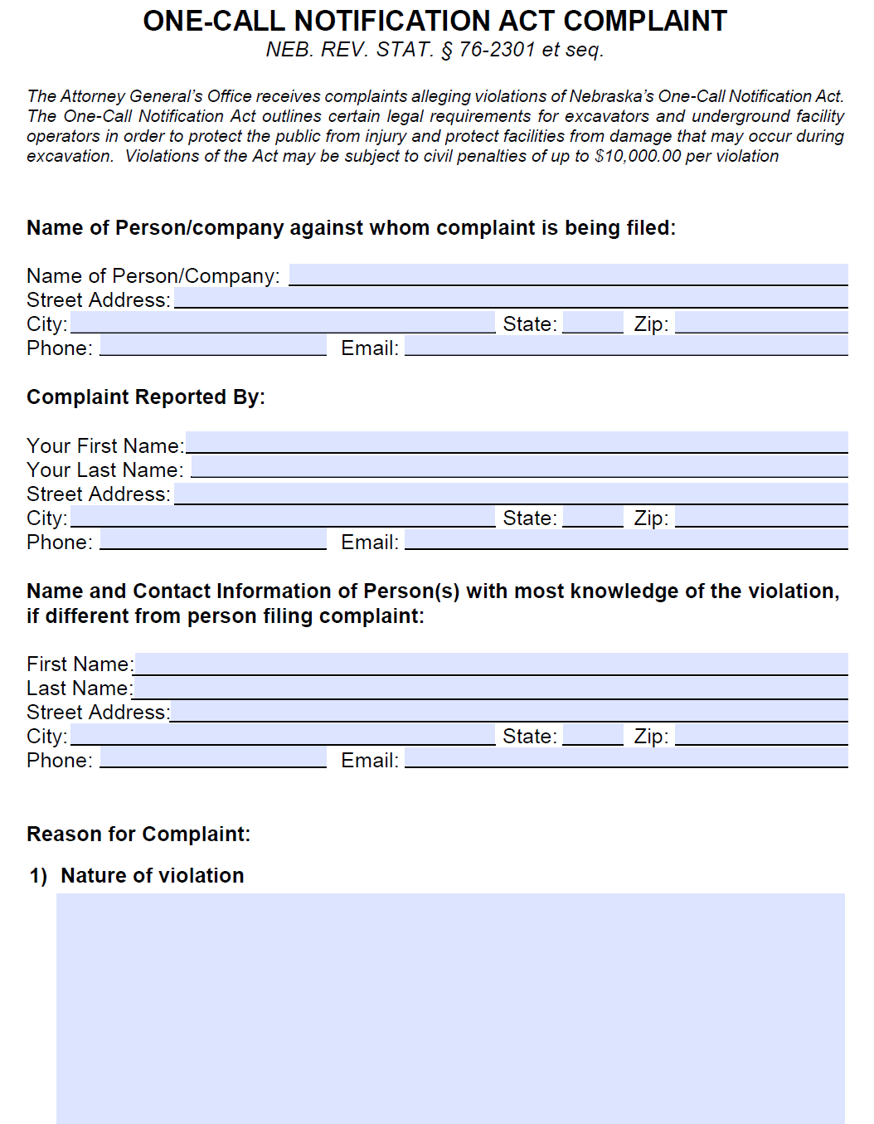
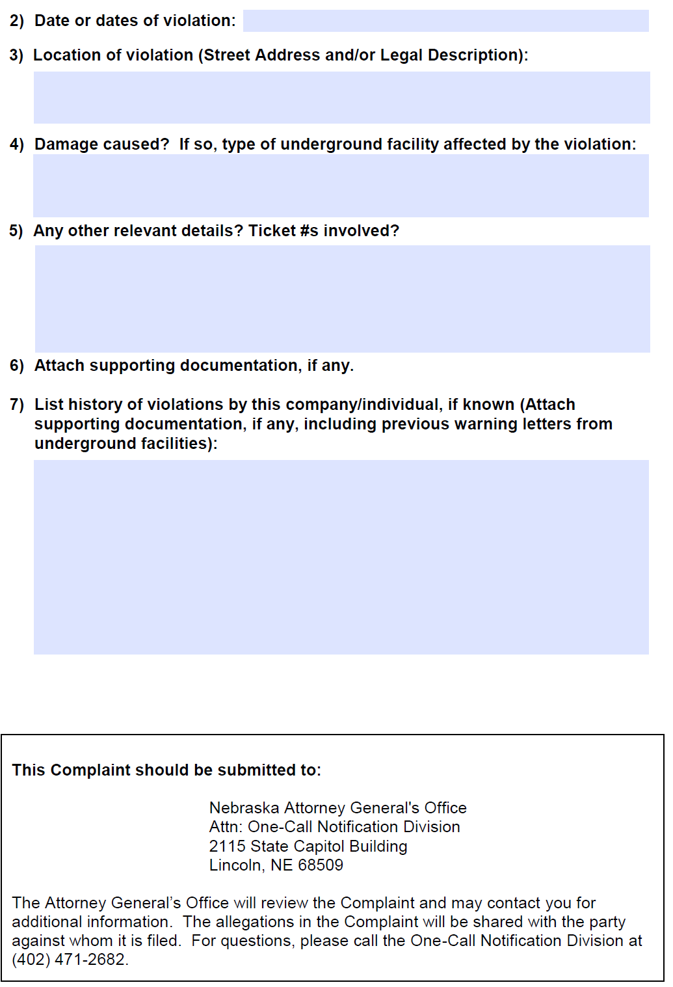
REPORT ONE CALL VIOLATIONS
Reporting Period October 2014 – September 2015
36 investigatory files opened
29 files closed
25 files placed in remediation/still in remediation (settlement reached, civil penalty assessed: monitoring compliance with Act for a period of time pursuant to Consent Decree)
Civil penalties assessed: $35,000
  Assessed civil penalties may be waived if Contractor maintains compliance for a period of time and attends a Damage Prevention Safety Education course approved by the State Fire Marshal
31 files still open and under investigation
Nebraska Attorney General’s Complaint Form

Slide 47
REPORT ONE CALL VIOLATIONS
Nebraska Attorney General’s Office
The Process:
The Nebraska Attorney General’s Office receives an alleged report of violation(s) of Nebraska’s One Call Notification Act from either a Facility Owner or a Contractor
The AG’s office reviews the report and conducts additional investigation, if necessary
The alleged offender will receive written notice of a possible violation and be given the opportunity to respond to the complaint.
Possible outcomes can include, but not limited to: Warning letter, Damage Prevention Class, Consent Decree, Civil Penalty…

Slide 48
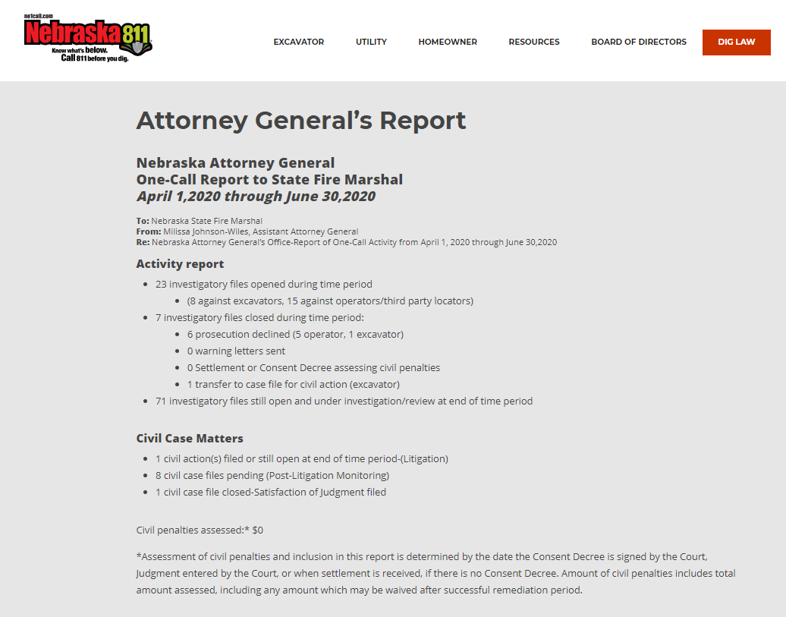
REPORT ONE CALL VIOLATIONS
Nebraska Attorney General’s Report
Reporting Period October 2014 – September 2015
36 investigatory files opened
29 files closed
25 files placed in remediation/still in remediation (settlement reached, civil penalty assessed: monitoring compliance with Act for a period of time pursuant to Consent Decree)
Civil penalties assessed: $35,000
  Assessed civil penalties may be waived if Contractor maintains compliance for a period of time and attends a Damage Prevention Safety Education course approved by the State Fire Marshal
31 files still open and under investigation

Slide 49

PUBLIC AWARENESS
Nebraska811
Help spread the Safe Digging message!
Order FREE educational material at www.ne1call.com
Notes:
Keyword – active excavation.

Slide 50
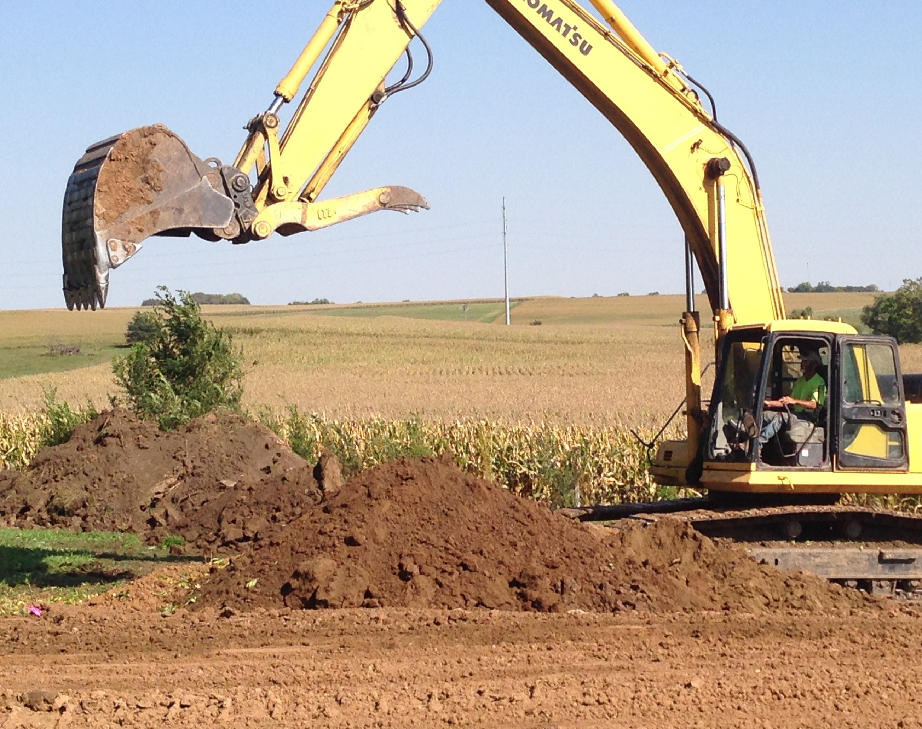

Damage Prevention is No Accident
Questions?
Contact Jill Geyer at jillgeyer@occinc.com or visit the Nebraska811 website www.ne1call.com

